Slide 1
MachineLearning _Clustering
-Rathiga Ramesh

Slide 2
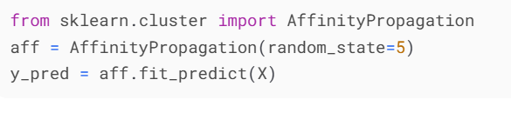
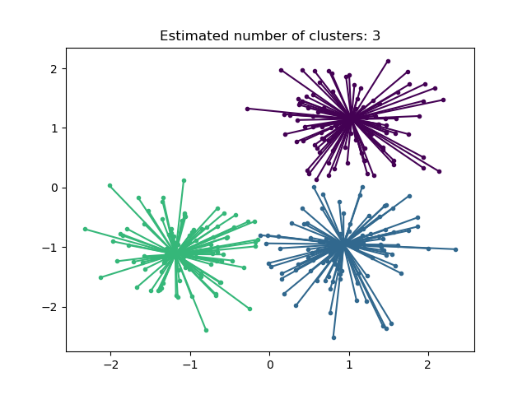
Affinity Propagation
How it works:
Uses "message passing" between data points to identify exemplars (most representative points).
Does not require pre-specifying the number of clusters.
Strengths:
Works well with small to medium-sized datasets.
Finds natural clusters without forcing a fixed structure.
Weaknesses:
High computational cost (O(N²) memory/time complexity).
Sensitive to damping factor and preference parameter.
Best for:
Small datasets where the number of clusters is unknown (e.g., gene expression, image segmentation).

Slide 3
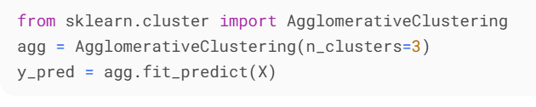
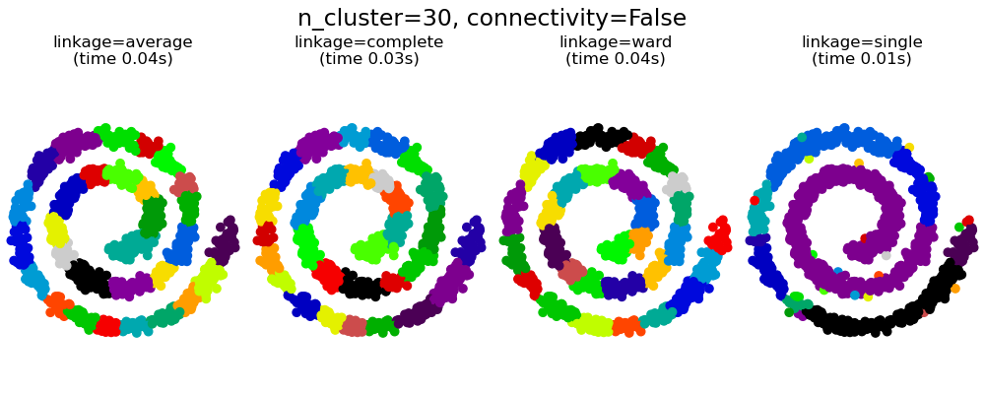
AgglomerativeClustering (Hierarchical Clustering)
How it works:
Bottom-up approach: Starts with each point as a cluster, then merges closest pairs iteratively.
Uses linkage criteria (ward, complete, average, single).
Strengths:
Produces a dendrogram for multi-level clustering analysis.
Flexible with different distance metrics.
Weaknesses:
Not scalable for large datasets (O(N³) time complexity).
Once merged, clusters cannot be split.
Best for:
Medium-sized datasets where hierarchy matters (e.g., taxonomy, document clustering).

Slide 4
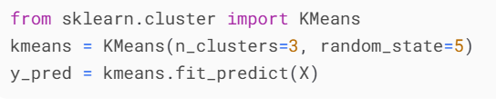
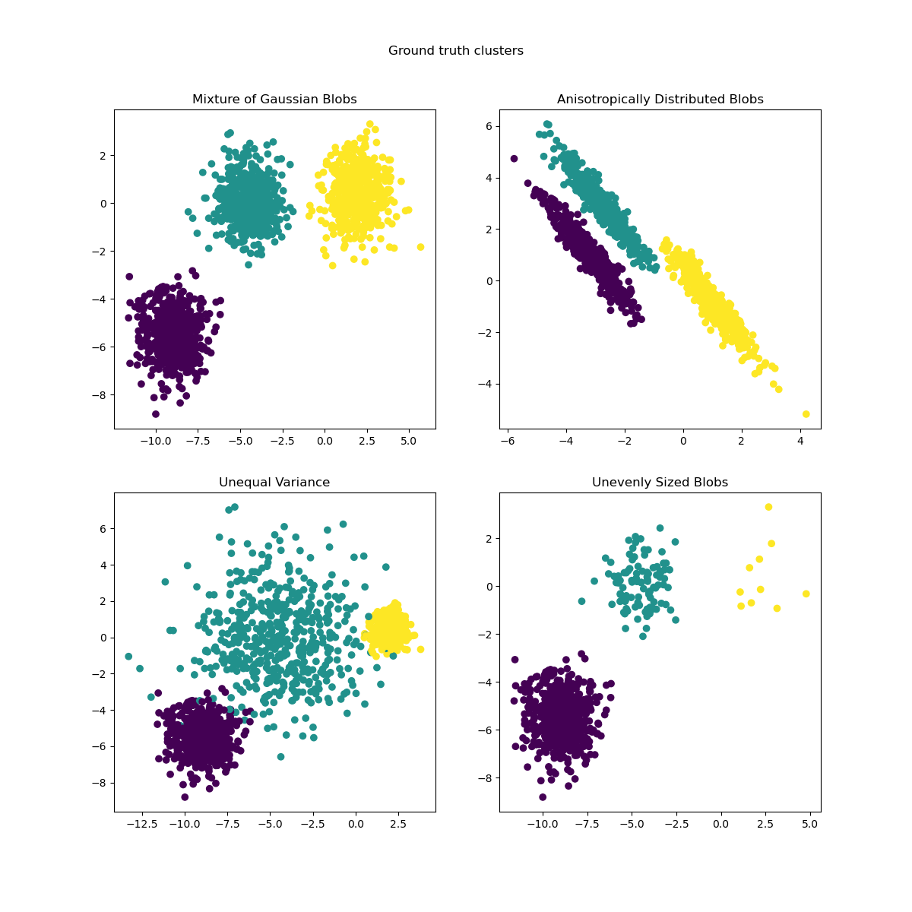
K-Means
How it works:
Partitions data into K clusters by minimizing inertia (within-cluster variance).
Uses iterative centroid updates.
Strengths:
Fast and scalable (O(N*K) per iteration).
Works well with spherical clusters.
Weaknesses:
Sensitive to initialization (k-means++ helps).
Struggles with non-convex clusters.
Best for:
Large datasets with clear separation (e.g., market segmentation, image compression).

Slide 5
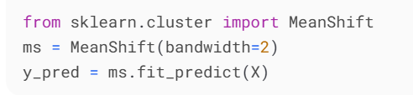
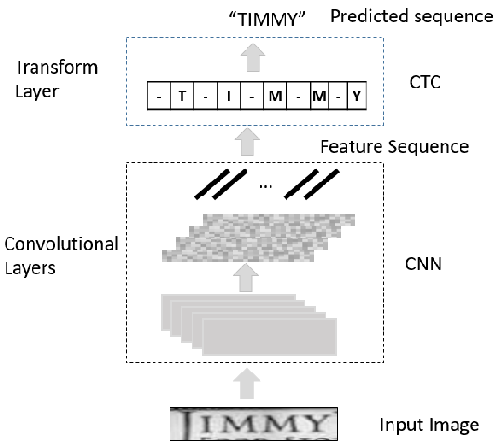
Mean Shift
How it works:
Kernel density estimation to find cluster modes.
Shifts points towards high-density regions.
Strengths:
No predefined cluster count needed.
Robust to outliers.
Weaknesses:
Computationally expensive (O(N²)).
Bandwidth selection is critical.
Best for:
Image segmentation, object tracking.

Slide 6
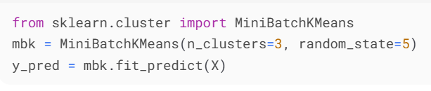
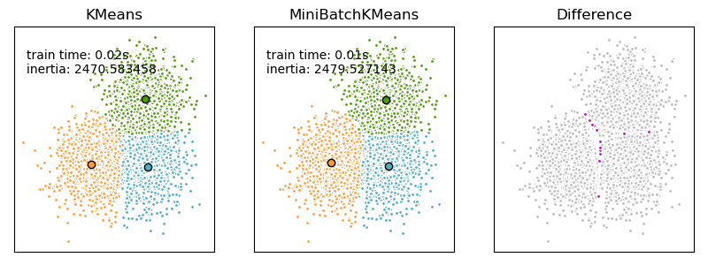
MiniBatch K-Means
How it works:
Approximate K-Means using random mini-batches.
Faster but less accurate than full K-Means.
Strengths:
Scalable to very large datasets.
Useful for online learning.
Weaknesses:
Lower accuracy due to approximations.
Best for:
Big data applications (e.g., real-time clustering, recommendation systems).

Slide 7
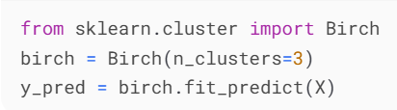
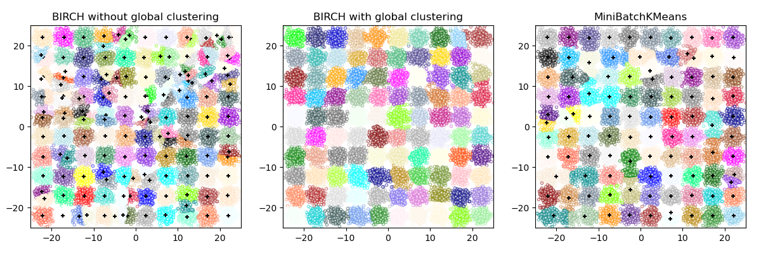
BIRCH (Balanced Iterative Reducing & Clustering using Hierarchies)
How it works:
Builds a Clustering Feature (CF) Tree for incremental clustering.
Compresses data into subclusters before final clustering.
Strengths:
Memory-efficient for large datasets.
Handles high-dimensional data better than K-Means.
Weaknesses:
Sensitive to input order of data.
Struggles with non-spherical clusters.
Best for:
Large-scale datasets (e.g., customer segmentation, anomaly detection).

Slide 8
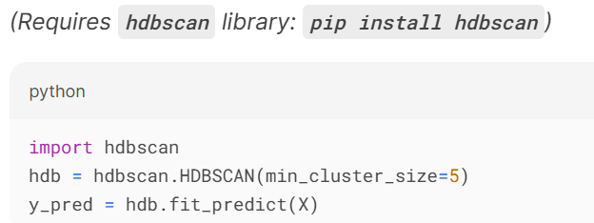
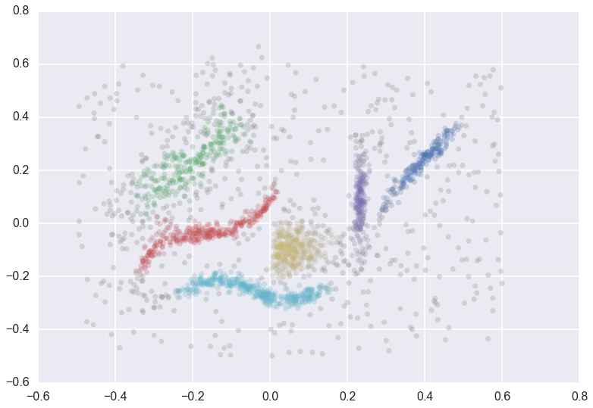
HDBSCAN (Hierarchical DBSCAN)
How it works:
Extends DBSCAN with hierarchical clustering.
Automatically extracts clusters using stability analysis.
Strengths:
No need for eps parameter (unlike DBSCAN).
Better for varying densities.
Weaknesses:
Slower than DBSCAN.
Best for:
Complex datasets with varying densities (e.g., bioinformatics, social network analysis).

Slide 9
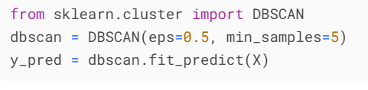
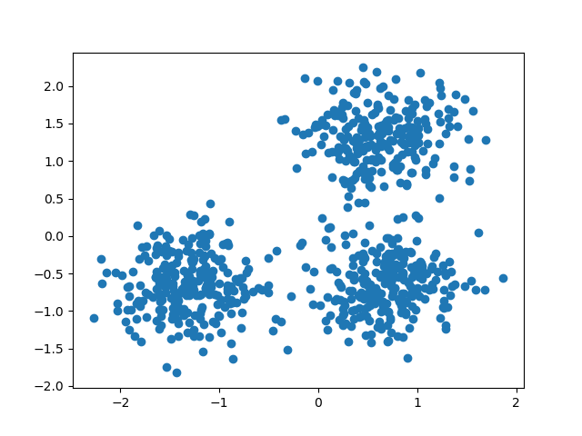
DBSCAN (Density-Based Spatial Clustering of Applications with Noise)
How it works:
Groups points based on density (core, border, noise points).
No predefined cluster count needed.
Strengths:
Robust to noise and arbitrary cluster shapes.
Works well with spatial data.
Weaknesses:
Struggles with varying densities.
Sensitive to eps and min_samples parameters.
Best for:
Anomaly detection, geographic data, and irregularly shaped clusters.

Slide 10
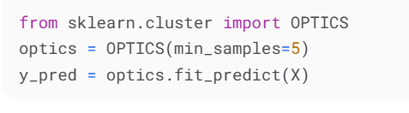
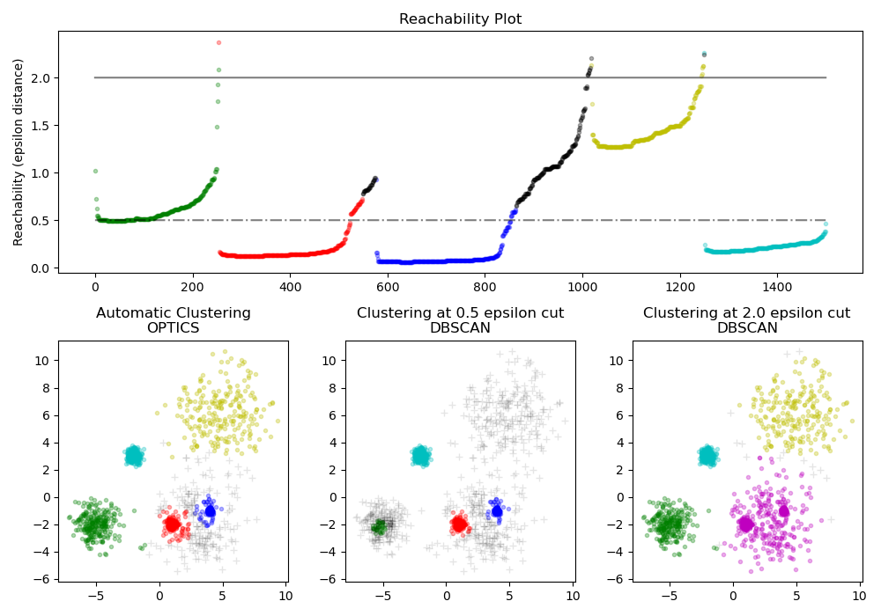
OPTICS (Ordering Points To Identify Clustering Structure)
How it works:
Generalized DBSCAN that creates a reachability plot.
Extracts clusters at multiple density levels.
Strengths:
Handles varying densities better than DBSCAN.
No single eps parameter needed.
Weaknesses:
Slower than DBSCAN.
Best for:
Datasets with nested clusters (e.g., astronomy, geology).

Slide 11
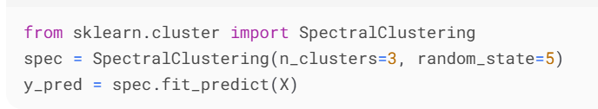
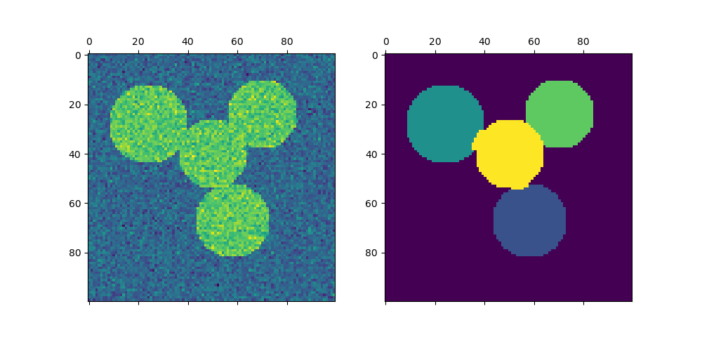
Spectral Clustering
How it works:
Uses graph Laplacian to project data into lower dimensions.
Applies K-Means on eigenvectors.
Strengths:
Works with non-convex clusters.
Effective for graph-based data.
Weaknesses:
Not scalable (O(N³) for eigen decomposition).
Best for:
Image segmentation, community detection in networks.

Slide 12
Summary Table
Algorithm | Best For | Strengths | Weaknesses
AffinityPropagation | Small datasets, unknown K | No need for K, finds exemplars | High computational cost
Agglomerative | Hierarchical clustering | Dendrogram, flexible linkage | Slow for large data
BIRCH | Large datasets | Memory-efficient, fast | Sensitive to data order
DBSCAN | Noise, irregular shapes | No predefined K, robust | Struggles with varying density
K-Means | Large, spherical clusters | Fast, scalable | Needs K, sensitive to init
HDBSCAN | Varying densities | Automatic K, robust | Slower than DBSCAN
Mean Shift | Density peaks | No K needed | Computationally heavy
OPTICS | Nested clusters | Multi-density handling | Slower than DBSCAN
Spectral | Non-convex clusters | Works on graphs | Not scalable

Slide 13
Summary Table with Visual Behavior
Algorithm | Type | Diagram Behavior | Best Use Case
K-Means | Partition-based | Spherical clusters | Well-separated data
DBSCAN | Density-based | Arbitrary shapes, noise-resistant | Spatial data, anomalies
Agglomerative | Hierarchical | Dendrogram, nested clusters | Taxonomy, bioinformatics
Mean Shift | Density-based | Smooth blobs, no fixed K | Image segmentation
Affinity Prop. | Exemplar-based | Finds "representative" points | Small datasets
Spectral | Graph-based | Non-convex clusters | Image, network data
OPTICS | Density-hierarchy | Multi-level density clusters | Nested structures
BIRCH | Hierarchical | CF-Tree compression | Large-scale data

Slide 14
When to Use Which?
Default choice: K-Means (if data is spherical and K is known).
Irregular shapes: DBSCAN / HDBSCAN.
Hierarchical structure: Agglomerative / BIRCH.
Unknown K: AffinityPropagation / Mean Shift / HDBSCAN.
Very large data: MiniBatch K-Means / BIRCH.

